Slide 1
Self Driving RC Car
Ethan Wells
Abigail Duran
Ethan Bishop
Alexis Perez

Slide 2
Ethan Wells
Week 9 progress
Goals for the week
Test printed sign cards using BuggyBot’s CM5 camera.
Progress for the week
Photographed 10 sign classes under three lighting conditions.
Prepared 329 camera crops with an OpenCV template-matching script.
Compared LISA, Mapillary, and combined models on the same crops.
Combined model: 329/329 correct (100% top-1).
Repository cleanup
Reorganized the Hardware and Model Training folders.
Updated maintained documentation and repaired moved-file links.
Hours spent on progress
7 hours

Slide 3
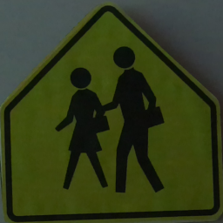
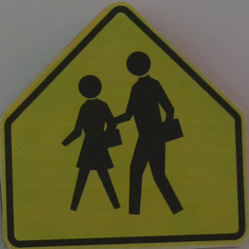
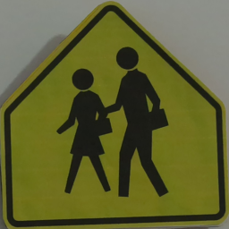
The combined model classified all camera crops correctly
Top-1 accuracy on the same 329 BuggyBot camera crops
LISA
47.7%
157 / 329
Mapillary
79.9%
263 / 329
Combined
100%
329 / 329
Sample camera crops: School sign
No light
Sunlight
Sunlight + artificial

Slide 4
Camera accuracy by sign
Top-1 accuracy on the printed-card camera crops
Sign | Photos | LISA | Mapillary | Combined
Added Lane | 33 | 33.3% | 100.0% | 100.0%
Keep Right | 33 | 72.7% | 100.0% | 100.0%
Merge | 33 | 0.0% | 100.0% | 100.0%
Pedestrian Crossing | 33 | 100.0% | 100.0% | 100.0%
School | 33 | 0.0% | 100.0% | 100.0%
Signal Ahead | 33 | 51.5% | 100.0% | 100.0%
Speed Limit 25 | 33 | 100.0% | 100.0% | 100.0%
Speed Limit 45 | 33 | 21.2% | 0.0% | 100.0%
Speed Limit 65 | 33 | 0.0% | 0.0% | 100.0%
Stop | 32 | 100.0% | 100.0% | 100.0%
Mapillary: speed-limit failures
Every Speed 45 and Speed 65 crop was misclassified (0/33 each).
LISA: color mismatch is a factor
Training includes many grayscale / near-grayscale crops; all 329 camera crops are color.
Grayscale conversion raised LISA from 47.7% to 59.6% on these same photos. It does not explain every error.
Speed limits 30 and 35 were not photographed; they are not planned for the track.

Slide 5
Test limits and goals for next week
The classifier passed this crop test; the live pipeline remains to be tested
Test limits
Goals for next week
329 photos represent about 30 setups; repeated frames are near-duplicates.
1. Connect the combined classifier to the CM5 camera and LCD pipeline.
Cropping used each sign’s known class and matching artwork.
2. Evaluate automatic sign crops without using the known class.
Distances and angles were not systematically varied in the recorded test.
3. Capture new setups at measured distances and angles; track accuracy and inference time.
Results measure cropped-sign classification; live sign detection and CM5 inference remain unverified.

Slide 6
Alexis Perez
Goals for the week
  OpenCV Learning and Testing
  Test vehicle components together
Progress for the week
  OpenCV testing on Webcam
  Ordered Chassis to test components
Goals for next week
  Implement OpenCV with RaspberryPi Camera
Hours spent on progress
  6 hours.

Slide 7
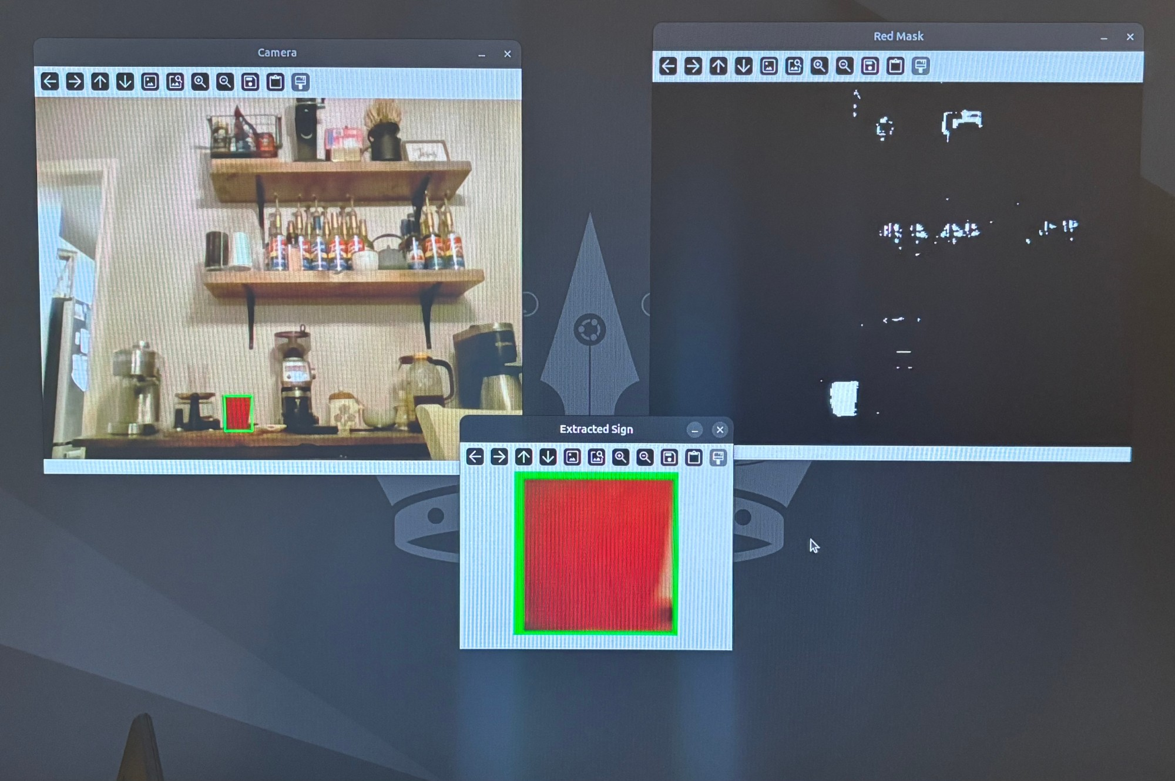

Slide 8
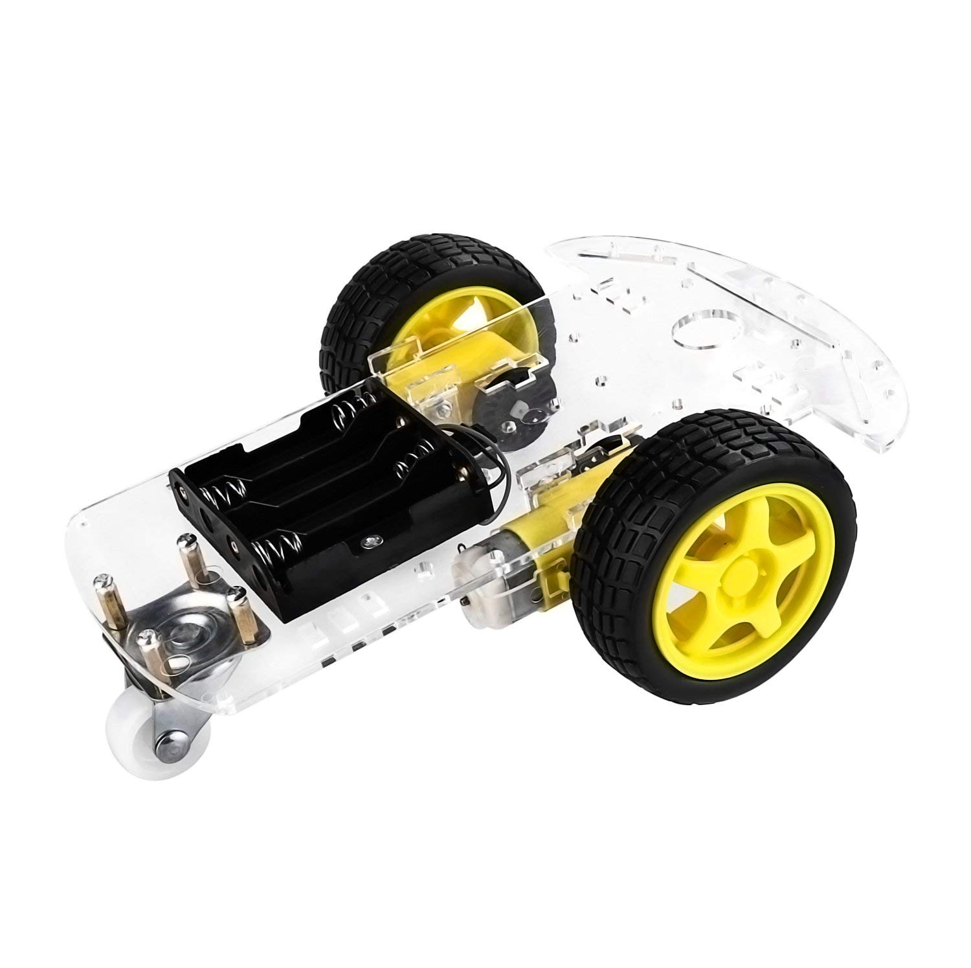
Test Chassis

Slide 9
Ethan Bishop
Goals for the week
  Research on a possible ROS 2 implementation
Progress for the week
  Installed ROS 2 under WSL
  Drafted the ROS 2 node architecture
Goals for next week
  Create a test program for ROS 2 implementation
Hours spent on progress
  6 hours.

Slide 10
ROS 2 could split our pipeline into eight nodes
Preliminary node structure for the car; each node does one job
Nodes
Why ROS 2
Camera: streams video from the Pi Camera Module 3
Sign detector: runs the vision model and reports each sign’s type, confidence and position
Line sensor: tracks the lane lines with TCRT5000 IR sensors
IMU: reports turning and motion; detects if the car is stuck
Behavior: a state machine that turns signs, lane position and IMU data into driving decisions
Motor driver: drives the wheels through the Waveshare HAT and stops if commands stop arriving
LCD: shows the car’s state and the last sign detected
Teleop: lets a person take over and drive manually
Each teammate can own a node without touching the others
Recorded drives can be replayed to test without the car
Laptops can watch the camera feed and topics live
Trade-off
More upfront setup than a single script, including a custom Docker build for the CM5 camera

Slide 11
The behavior node makes every driving decision
Draft ROS 2 data flow: boxes are nodes, arrows are topics
Line sensor
TCRT5000 IR sensors
/lane
Camera
Pi Camera Module 3
/image_raw
Sign detector
Vision model
/signs
Behavior
State machine
/cmd_vel
Motor driver
Waveshare HAT (I2C)
/cmd_vel
/imu
/status
(manual)
IMU
IMU (I2C)
LCD
LCD display (I2C)
Teleop
Laptop keyboard

Slide 12
Abigail Duran
Goals for the week
  Prepare the PCB design files with all currently selected components and required connections.
  Make sure the schematic reflects the components planned for the current BuggyBot hardware setup.
Progress for the week
  Created an organized component checklist/spreadsheet for the PCB design.
  Reviewed the CM5 IO Board components and connections to determine which features should be kept, removed, or modified.
  Added IMU and LCD connectors on the board.
Goals for next week​​​
  Continue developing the PCB design and component placement.
  Work toward finalizing the PCB design for manufacturing.
Hours spent on progress
  6 hours​

Slide 13
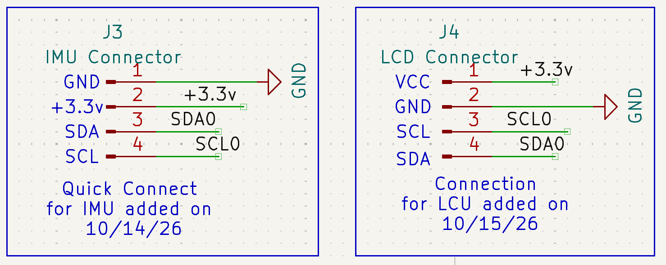

Slide 14
